Slide 1


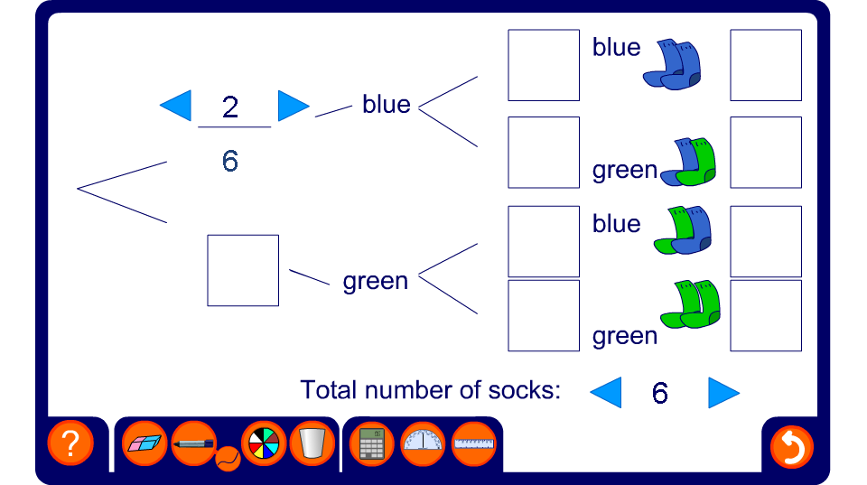


Probability without replacement activity
Notes:
Enter your own probability for the first blue sock and the total number of socks in the boxes at the bottom.
Pupils can then work out the missing probabilities in the tree diagram and the four combined probabilities, perhaps on mini whiteboards as a competition or race.

